Slide 1
Power Automate or Logic Apps – Which to Choose?

Slide 2
Power Automate or Logic Apps – Which to Choose?
Haniel Croitoru & Daniel Santos

Slide 3


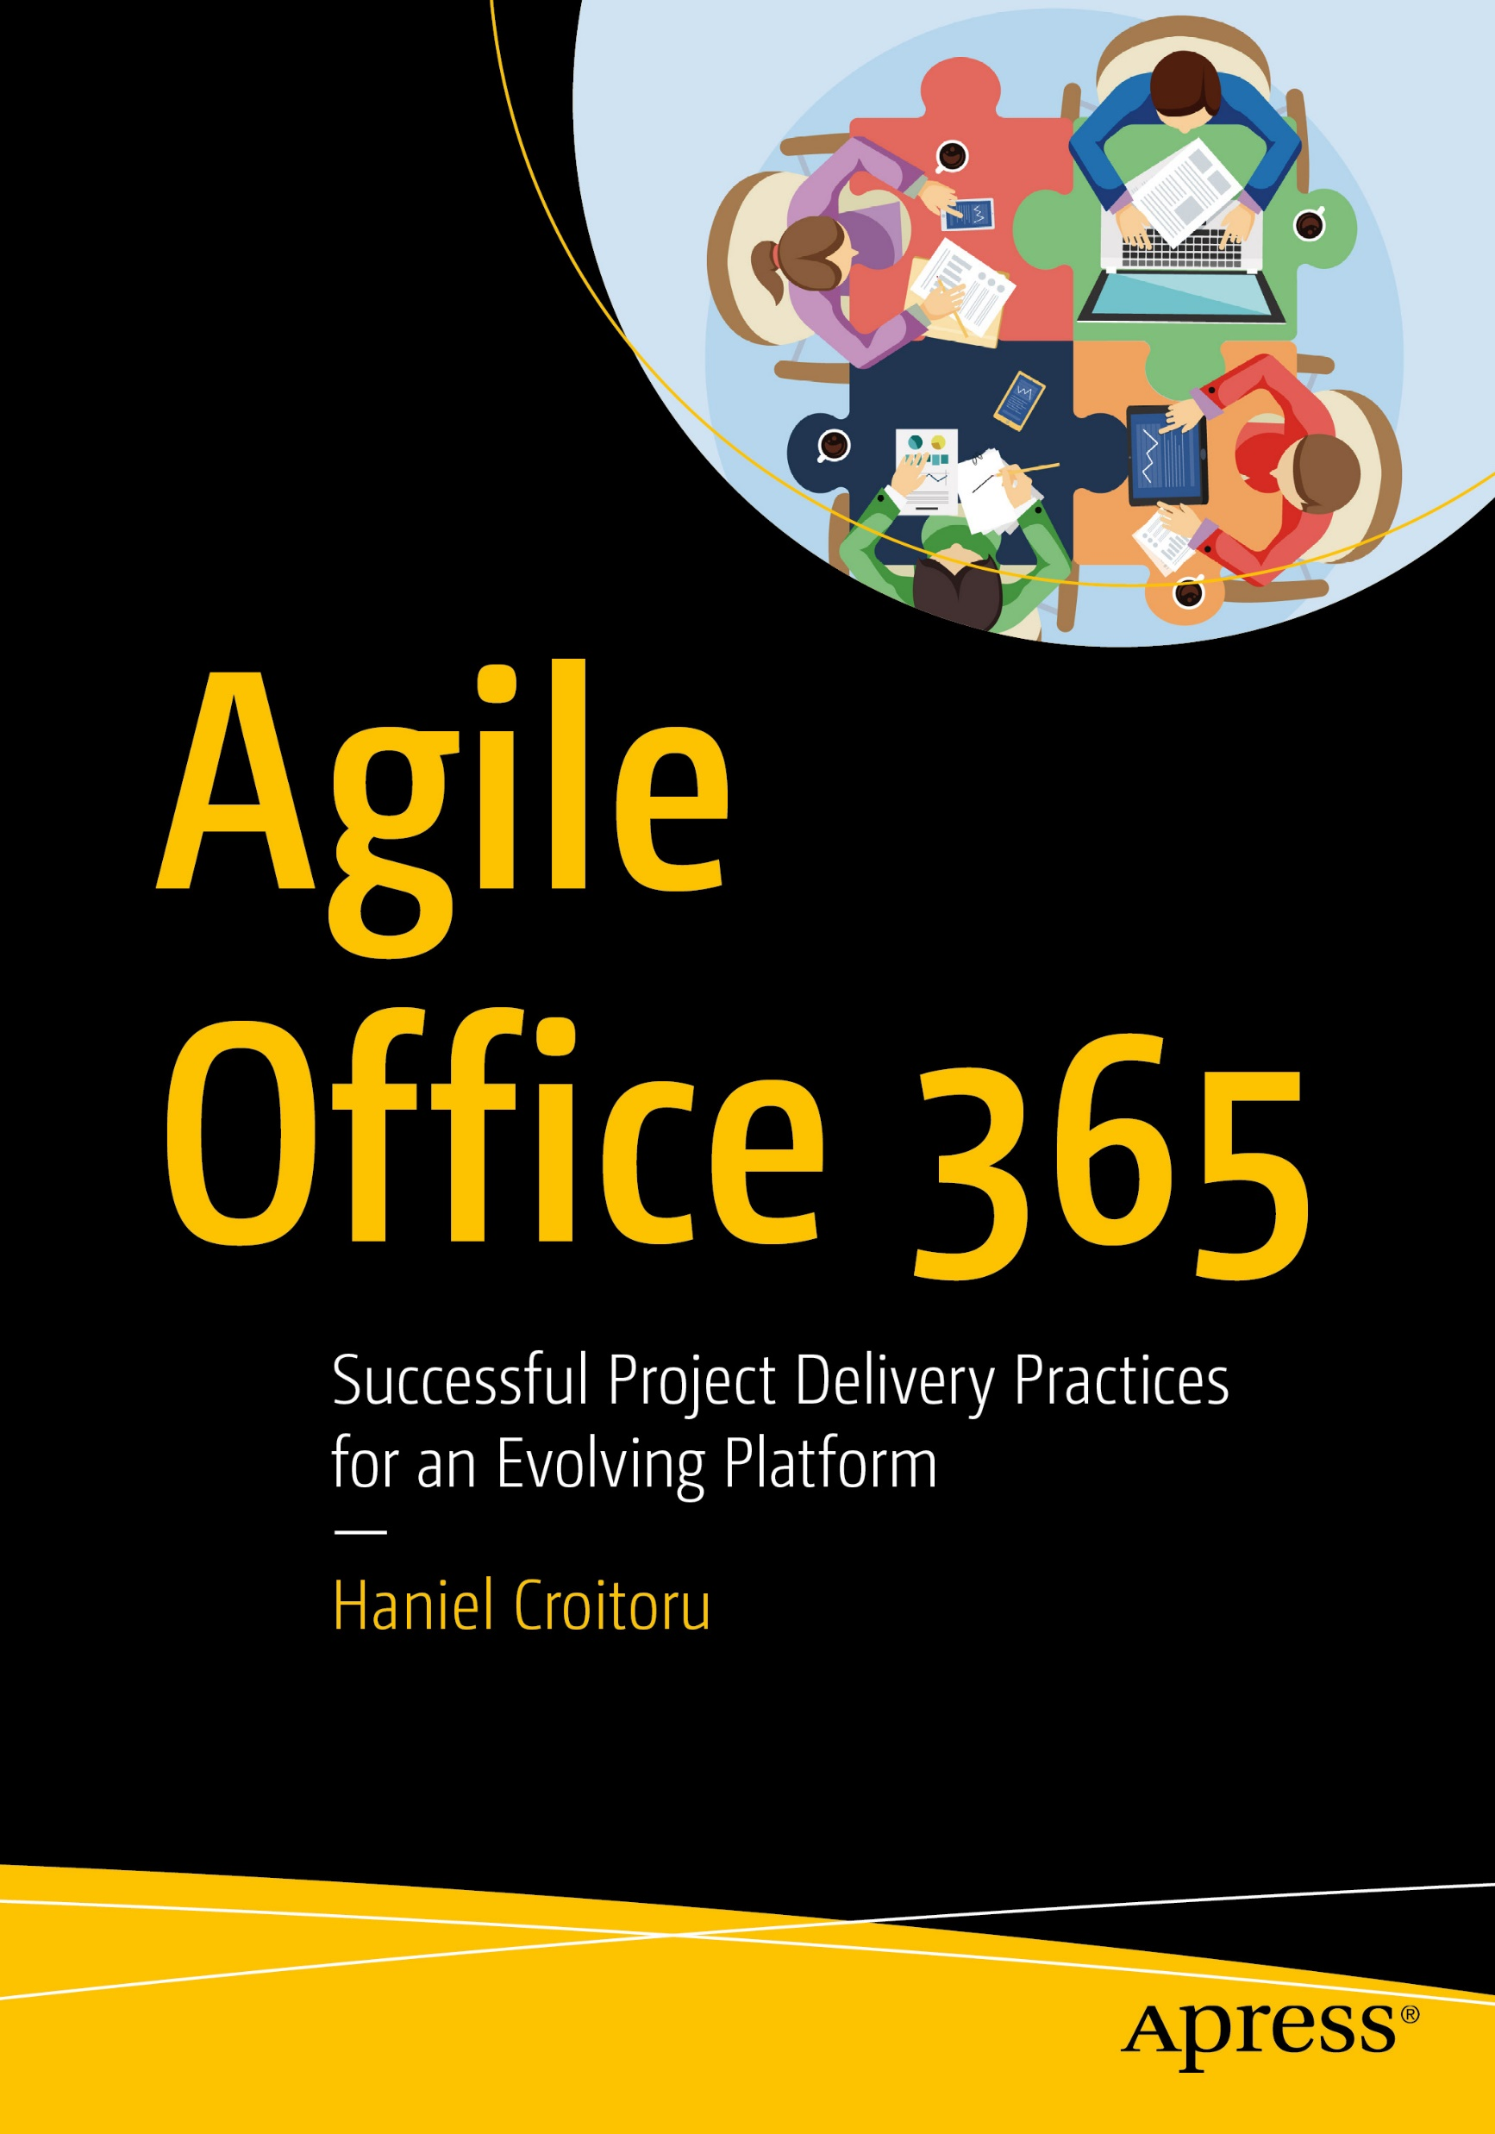


About us
Haniel Croitoru
“I’m passionate about simplifying life”
Super-Dad | Office 365 MVP | Speaker | Author
Daniel Santos
“If it's redundant enough, automate it!”
Power Automate Disciple | Speaker

Slide 4
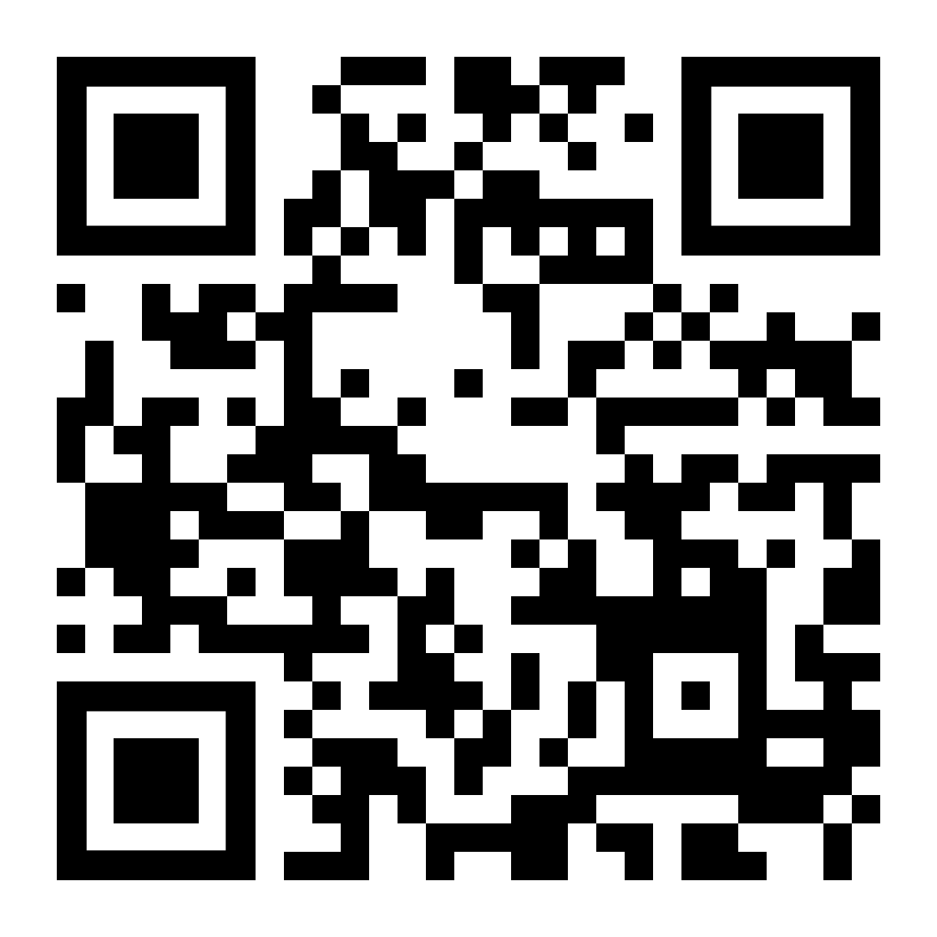
Power Automate or Logic Apps – Which to Choose?
Scan the QR Code to enter to win some great prizes.

Slide 5
Session Agenda
Usage and Management
Choosing the right solution
Overview
2
4
1
3
5
Functional Differences
Licensing
& Costing

Slide 6
OVERVIEW

Slide 7
WHY AUTOMATE
SAVE TIME – an automated task will usually run faster than when done manually
REDUCE WASTE – paper-based processes produce a lot of waste
REDUCE RISK – manual data-related tasks are more error prone
BUSINESS GROWTH – employees can now focus on revenue-generating initiatives
NO OTHER OPTION – LOB systems may not be available to individuals

Slide 8
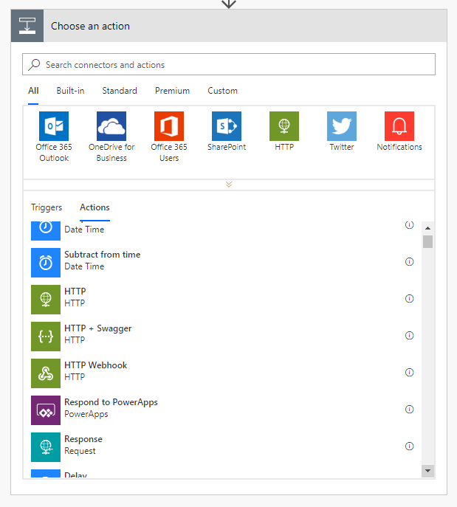
WORKFLOWS
Each workflow starts with a trigger
1+ steps that run after the trigger
Connect to cloud service or on-prem via the on-prem data gateway
Directly connect to HTTP endpoints if there’s no out-of-box connector
Some actions may not even use connections – just manipulate data locally

Slide 9
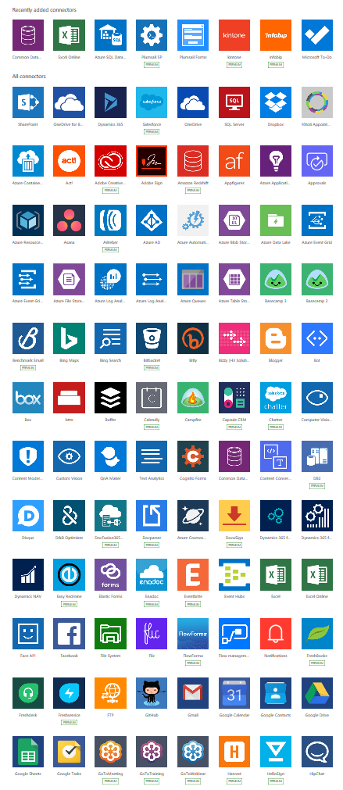
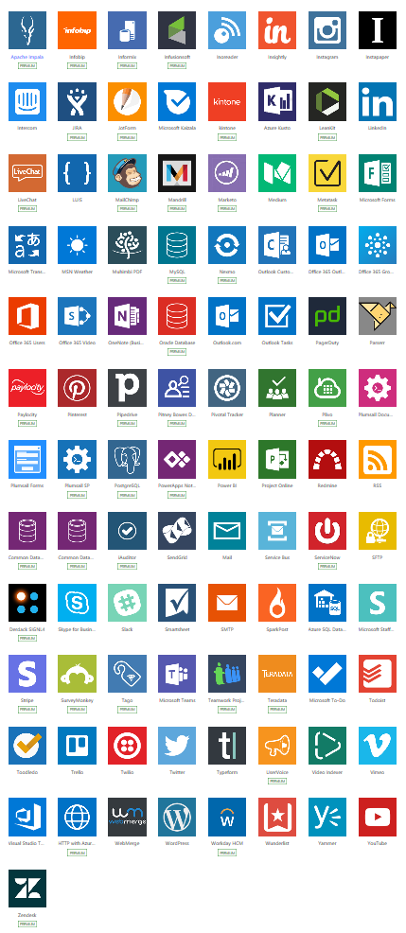
INTEGRATE WITH OTHER SERVICES
Over 250 SaaS-based connectors available today

Slide 10

POWER AUTOMATE AND LOGIC APPS
Power Automate
Logic Apps

Slide 11

POWER AUTOMATE AND LOGIC APPS

Slide 12
FUNCTIONAL DIFFERENCES

Slide 13

WORKFLOW TYPES
Power Automate
Logic Apps
Automated workflows
Automated workflows
Business Process flows
UI flows

Slide 14

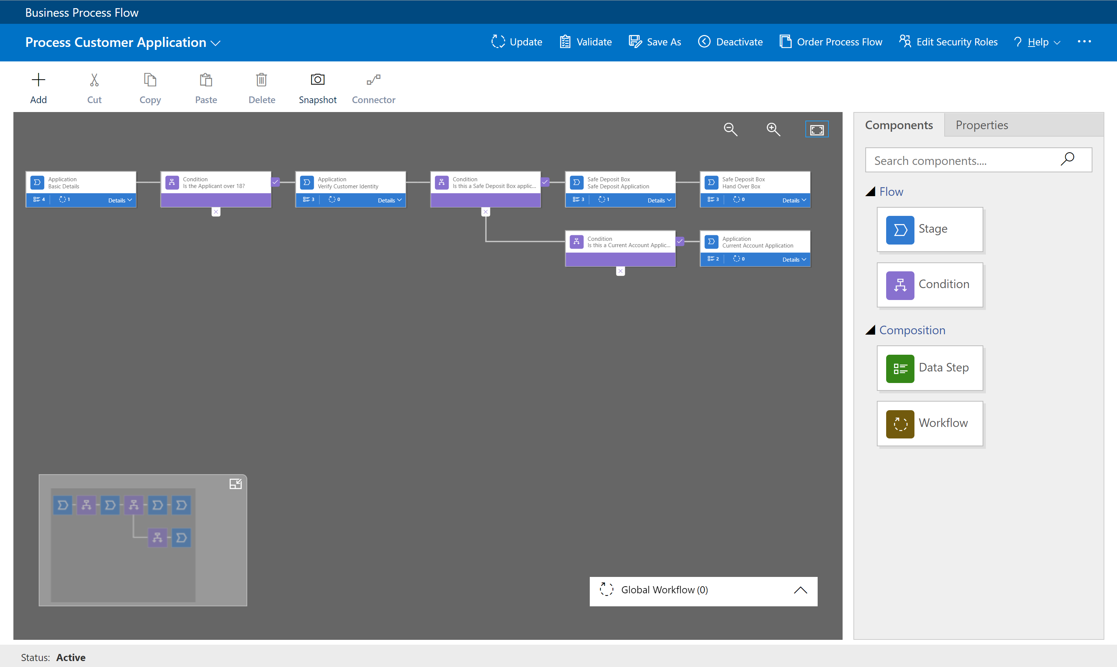
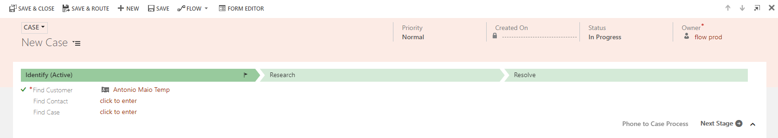
BUSINESS PROCESS
Used for managing the overall User process
Visual indicators that tell users where they are in the business process
Reduce the need for training
Configurable to support common line of business methodologies
Notes:
Employee Onboarding
Order business cards
Get the cubicle name tag from Mail room and put it in new cubicle
Place welcome package on desk
Etc.
We’ll only talk about the Automated Processes for this presentation

Slide 15
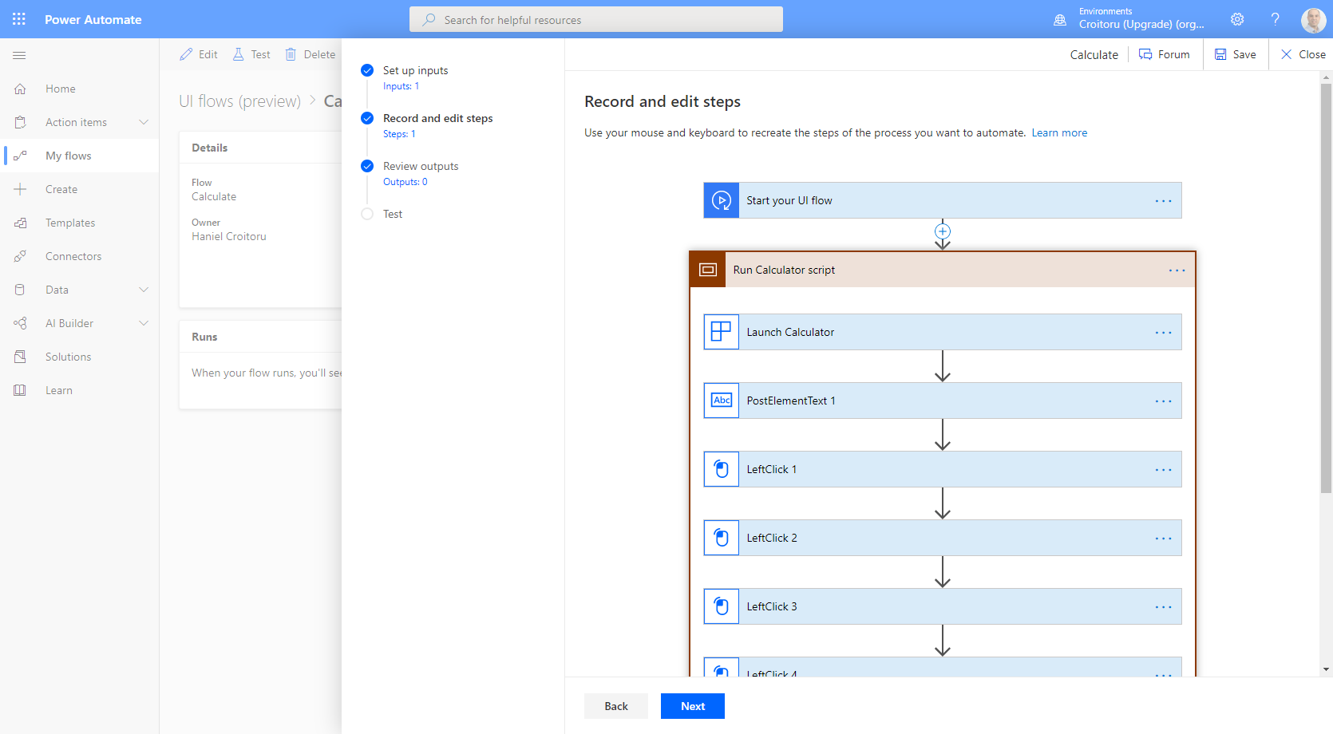
UI FLOW
Provides Robotic Process Automation (RPA) capabilities to Power Automate.
Automate repetitive tasks in Windows and Web applications.
Records and plays back user interface actions (clicks, keyboard input, etc.) for applications that don't have easy-to-use or complete APIs available.

Slide 16
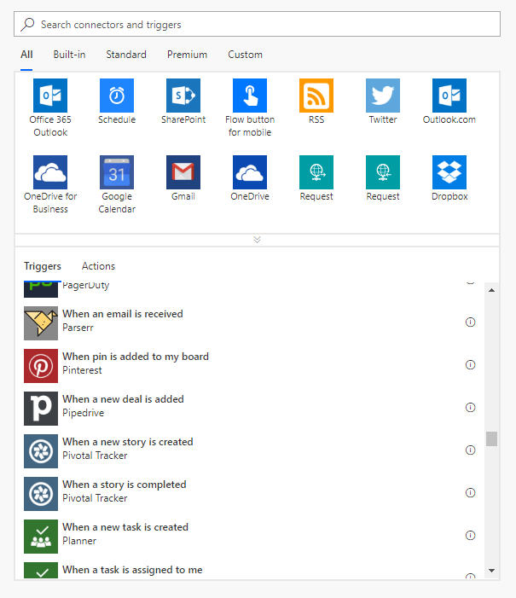
AUTOMATED WORKFLOW TRIGGERS
Triggers initiate a workflow. Depending on the task, different triggers may be needed
Power Automate
Logic Apps
Scheduled Triggers
Scheduled Triggers
Automated Triggers
Automated Triggers
Instant triggers

Slide 17
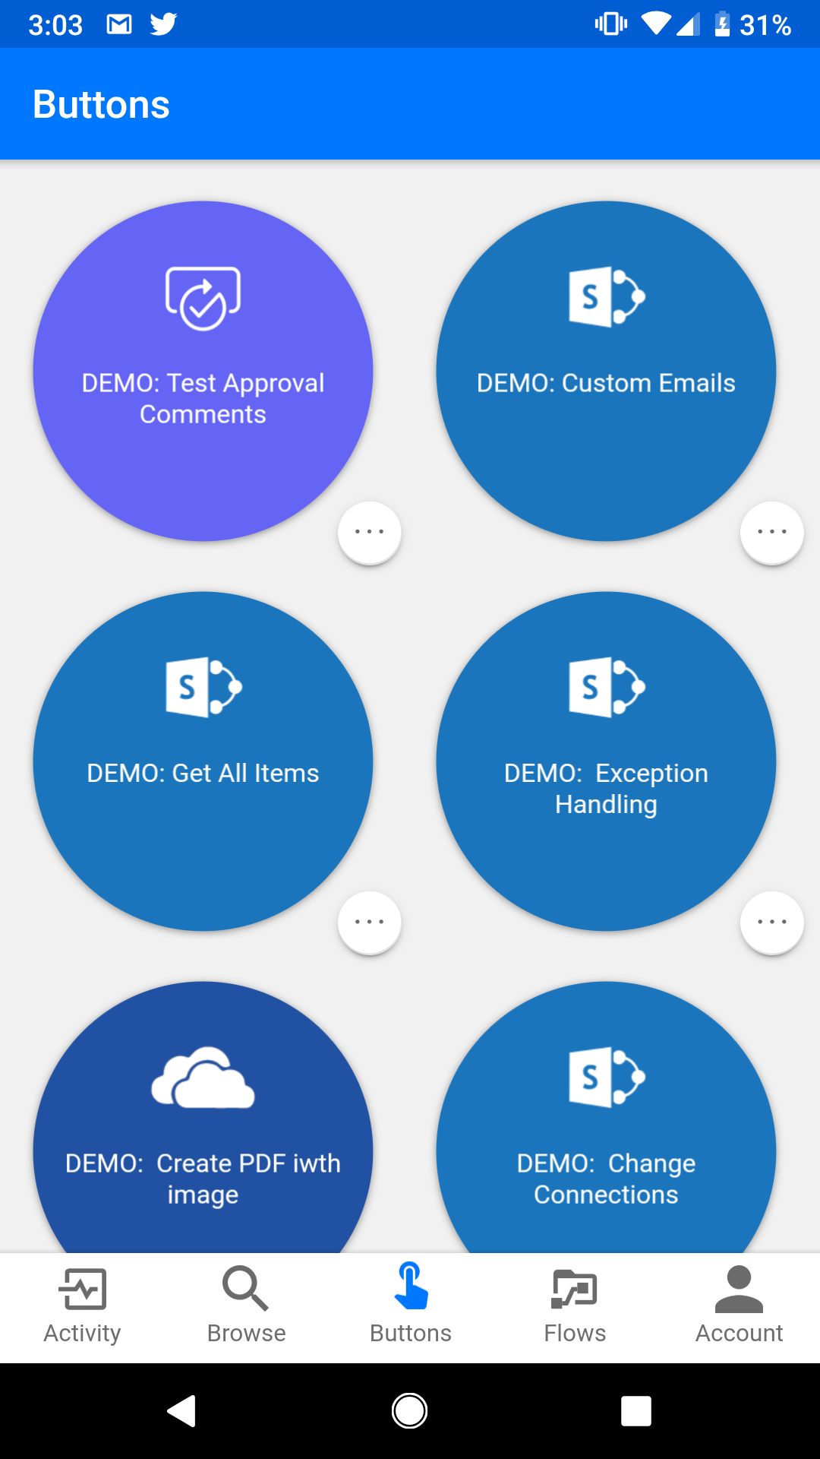
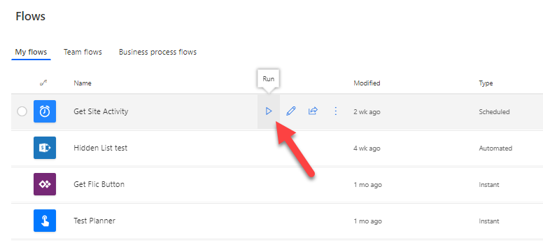
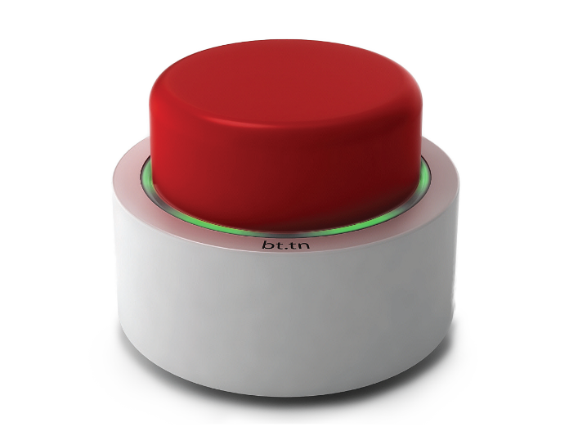

INSTANT TRIGGERS
Manual triggers may include optional input fields

Slide 18
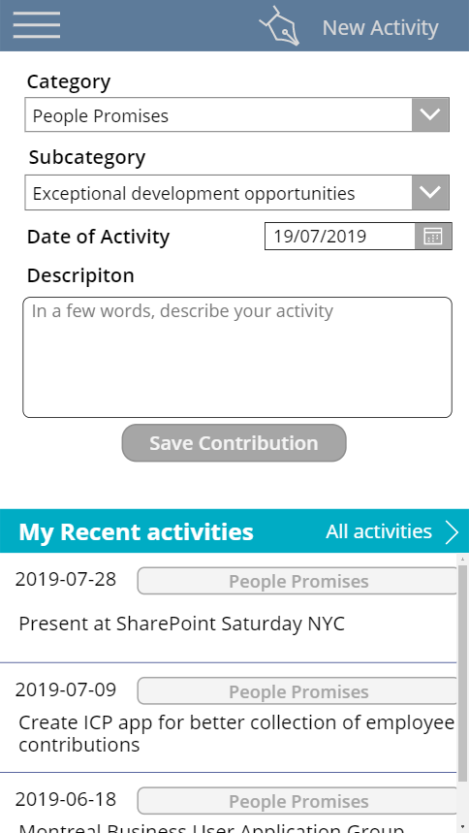
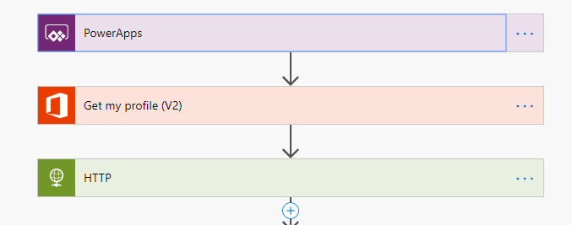
INTEGRATION WITH POWERAPPS
Power Automate has triggers and actions to send responses to Power Apps
Achieving similar functionality in Logic Apps requires custom connectors

Slide 19
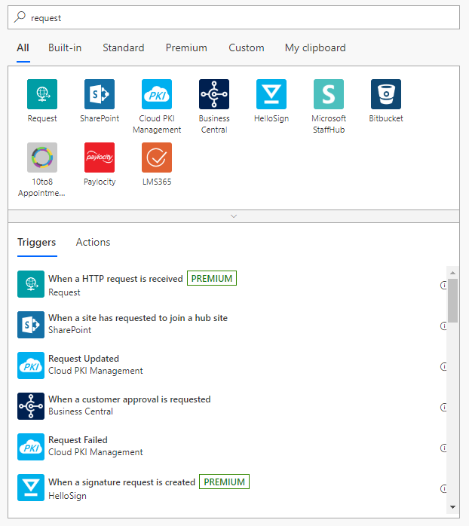
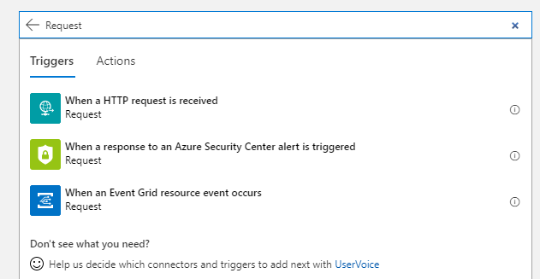
CONNECTOR NON-PARITY
Power Automate
Logic Apps
Although many connectors are shared, there are some differences.

Slide 20
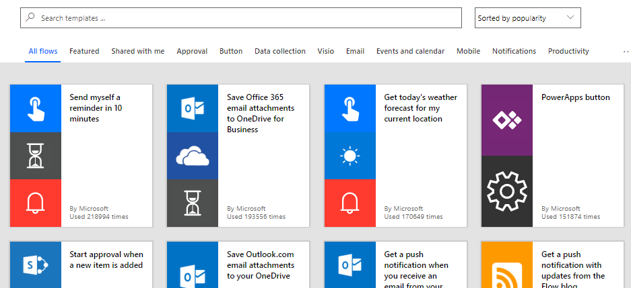
TEMPLATES FOR COMMON TASKS
Thousands of scenarios have been combined into reusable templates

Slide 21
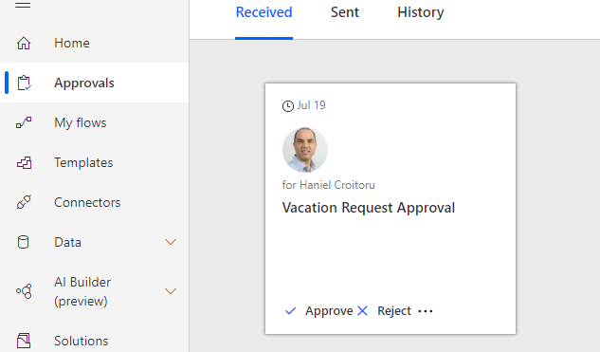
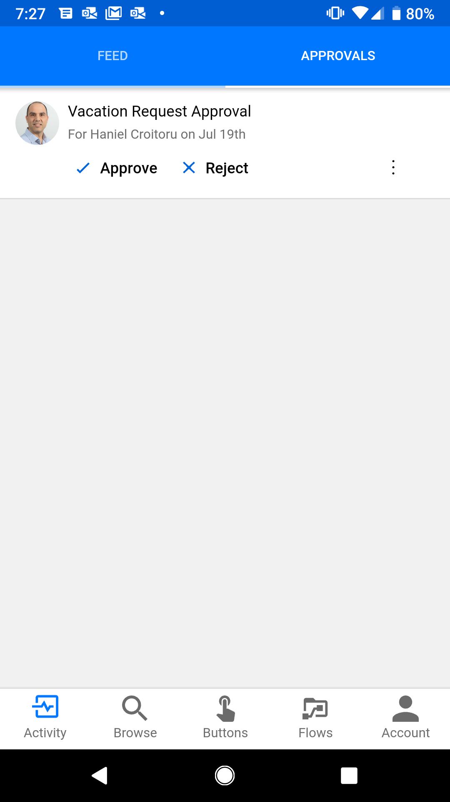
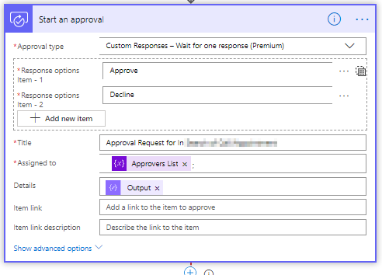
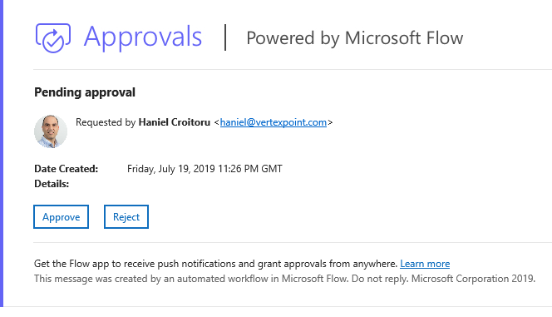
APPROVALS
Single-approve or All-approve actions can be added to Power Automate
Approvals can be provided via email, website, or the mobile app
In Logic Apps, build approvals using Outlook’s Send Approval Email; but there is no authentication

Slide 22
USAGE AND MANAGEMENT

Slide 23
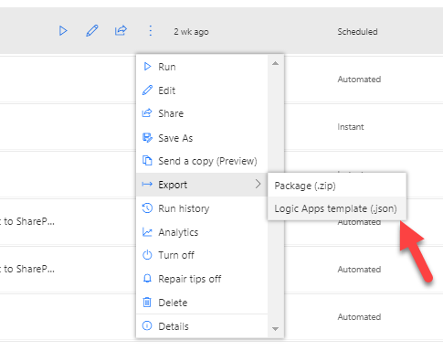
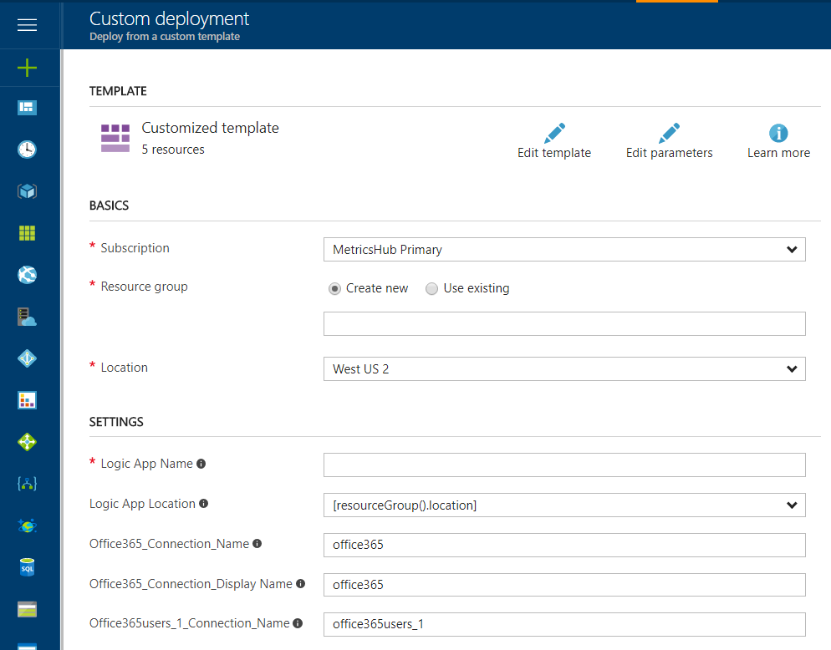
MIGRATING POWER AUTOMATE TO LOGIC APPS
Flows can be exported from the menu in JSON format
Once imported into Logic Apps, you will need to configure the Azure subscription, Resource group, Location and name
You will also need to re-create the connections used
CAVEAT: There may be connectors in the Power Automate that are not available in Logic Apps

Slide 24
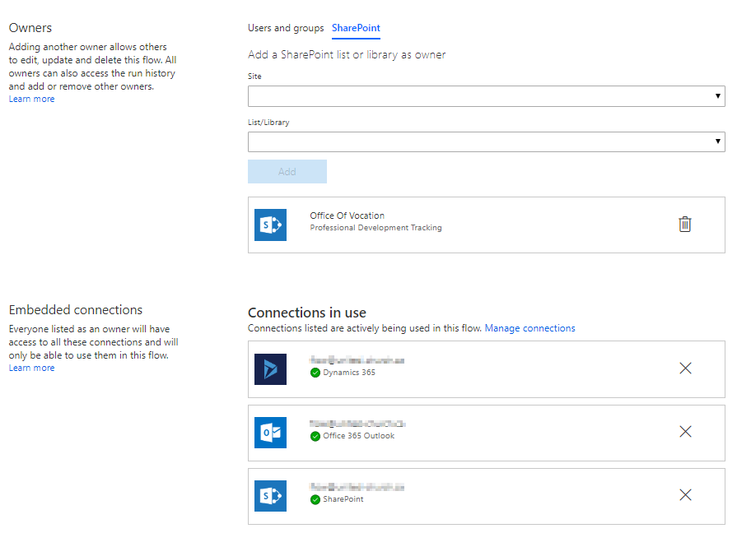
WORKFLOW OWNERSHIP
Owners can change the workflows
Power Automate flows can be owned by multiple users and even other resources, such as SharePoint groups
Logic Apps belong to a single user

Slide 25
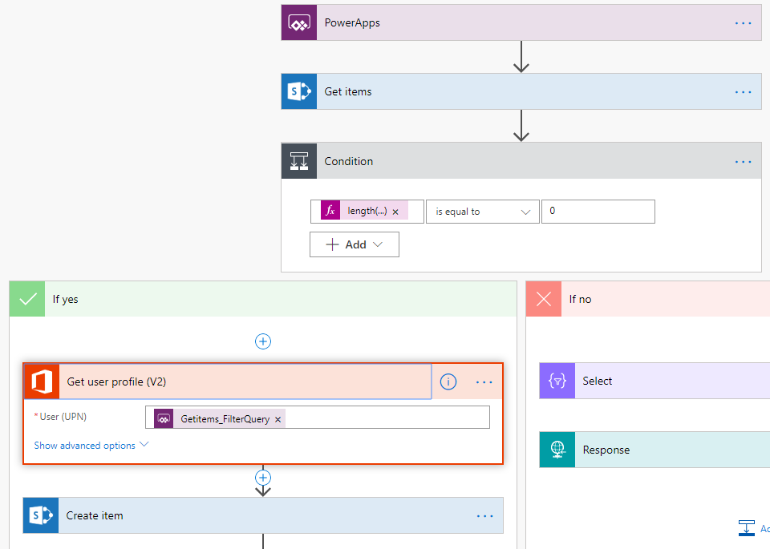
WORKFLOW RUNTIME CONTEXT
Who runs the workflow will impact the results provided
Depending on how a flow is triggered, the context of the flow is for that user
Power Automate flow triggered from a Power App
Logic Apps are always running in the context of the maker

Slide 26

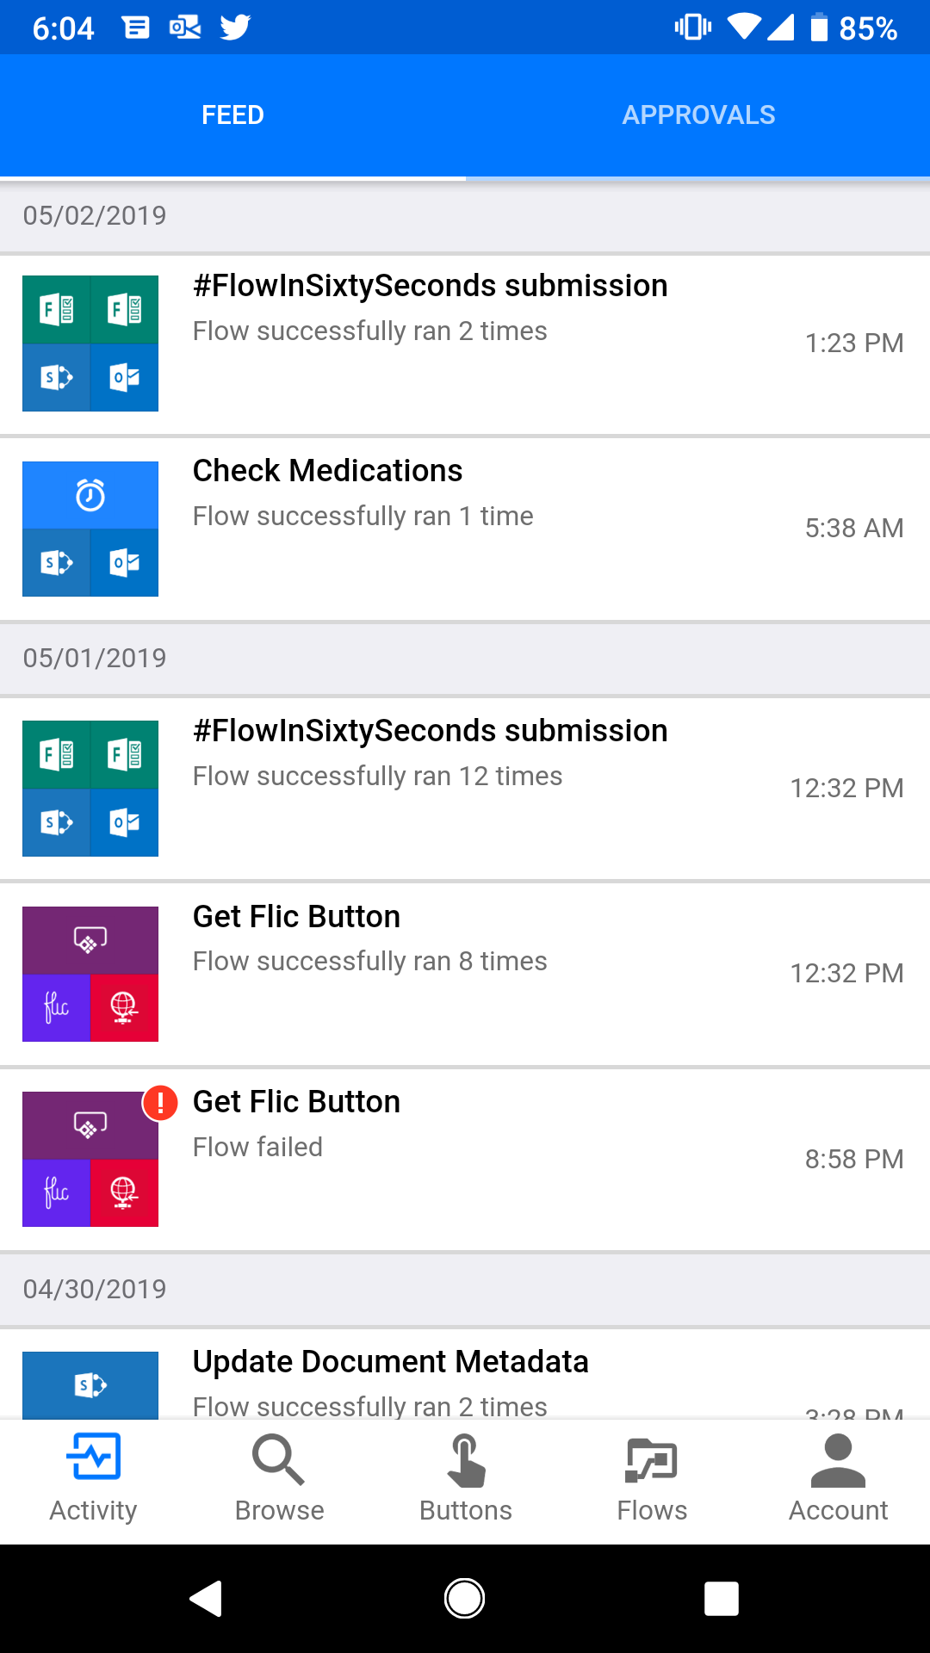
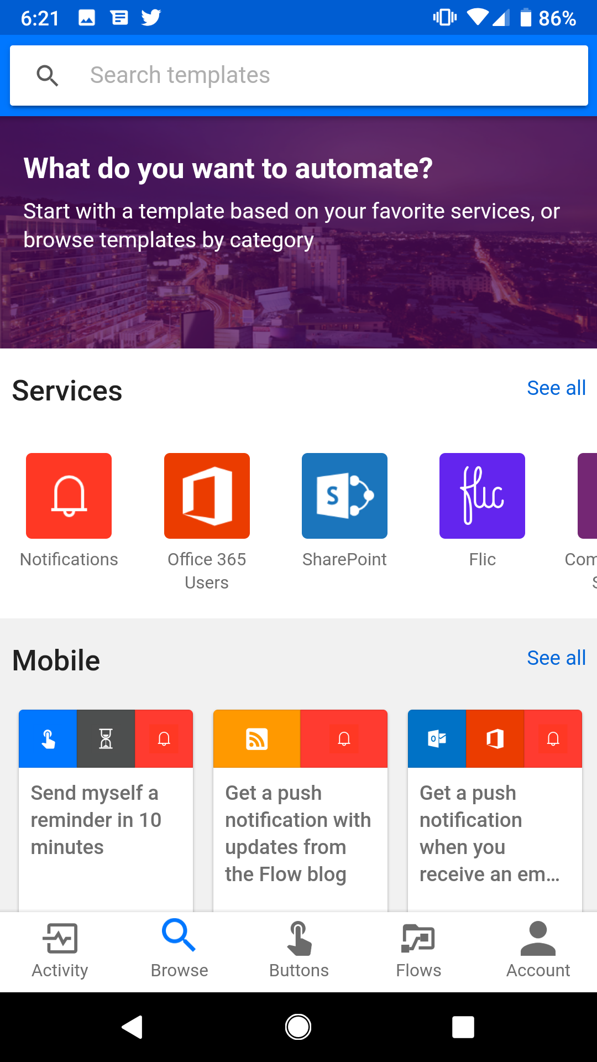
MICROSOFT FLOW MOBILE APP
Manage your Flows from anywhere
Key management activities include
Manually start flows
Review flow completion status and notifications
Edit flows

Slide 27
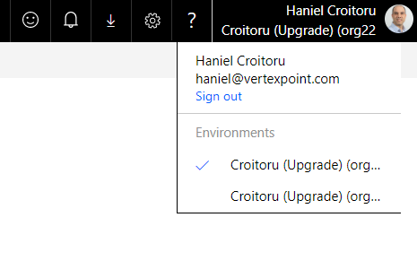
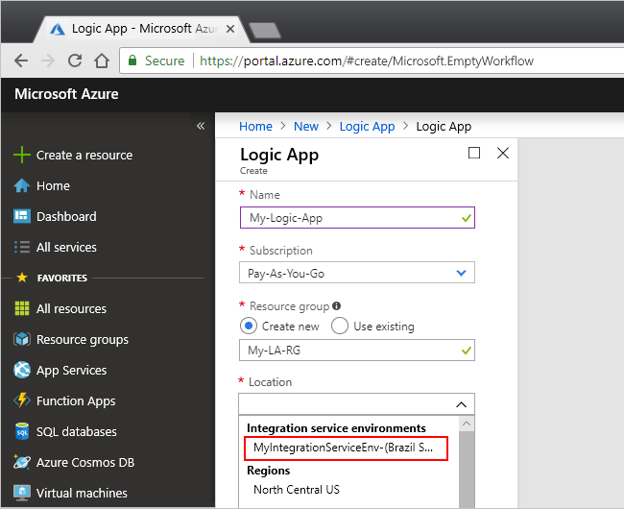
ENVIRONMENTS AND SOLUTIONS
Power Automate flows can be added into various Environments
Solutions allow you to group together related flows (and Power Apps) and collectively deploy them across environments
Logic Apps recently received the Integration Service Environment (ISE)
Isolated and dedicated Azure capacity provide predictable performance by avoiding intermittent slowdowns from co-tenancy that can impact business critical processes
Notes:
Flow subscriptions that have access to Flow Plan 2 have access to two environments
Logic Apps can source control and create a single ARM template to deploy Logic Apps and other parts of a larger solution that is based on Azure resources.

Slide 28
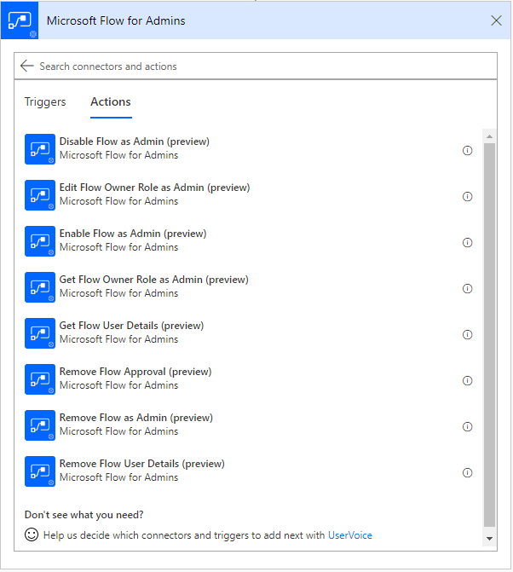
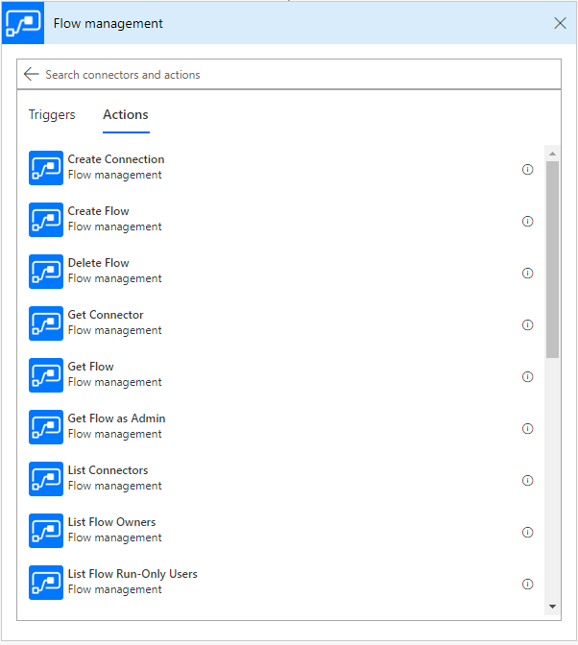
POWER AUTOMATE MANAGEMENT CONNECTORS
Let Power Automate manage Power Automate
Flows Management and Flow Management for Admin Connectors lets makers perform specific admin actions on Flows within their environments
CRUD Flows
Get inventory
Enable/Disable Flows
Manage Flow Owners

Slide 29
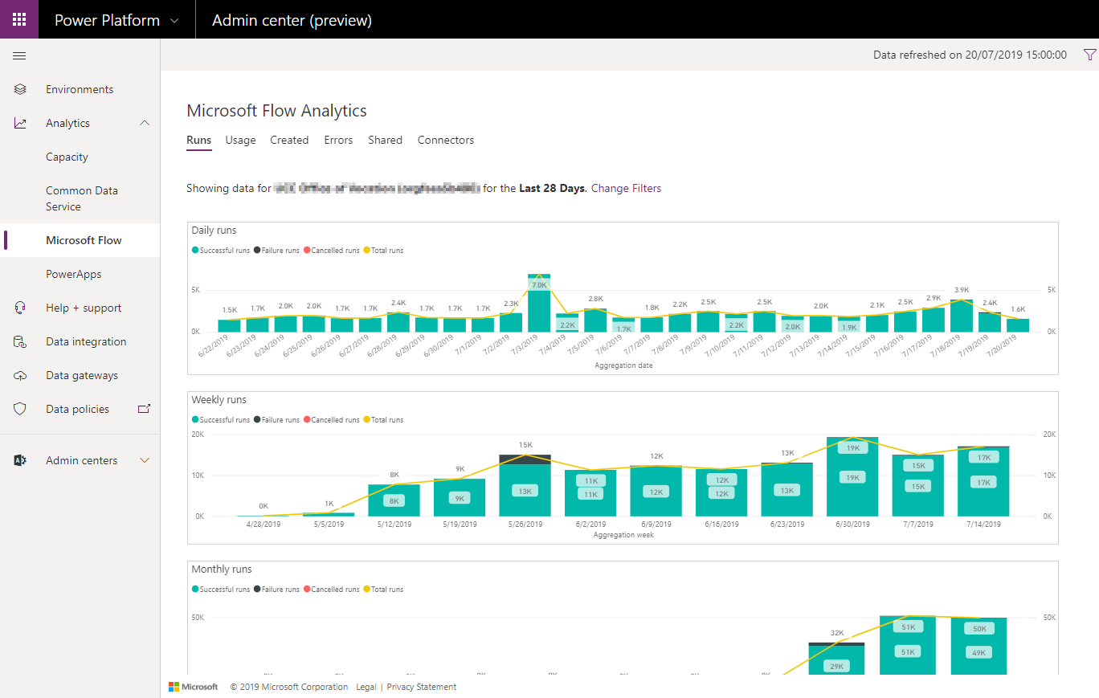
ANALYTICS
Discover how your flows are functioning
Through the Power Platform Admin Center, admins are able to get Power BI-based analytics regarding their flows, such as
Number of runs per day/week/month
What flows are used most frequently
Error types and counts
Who flows are shared with
What connectors are used in flows

Slide 30
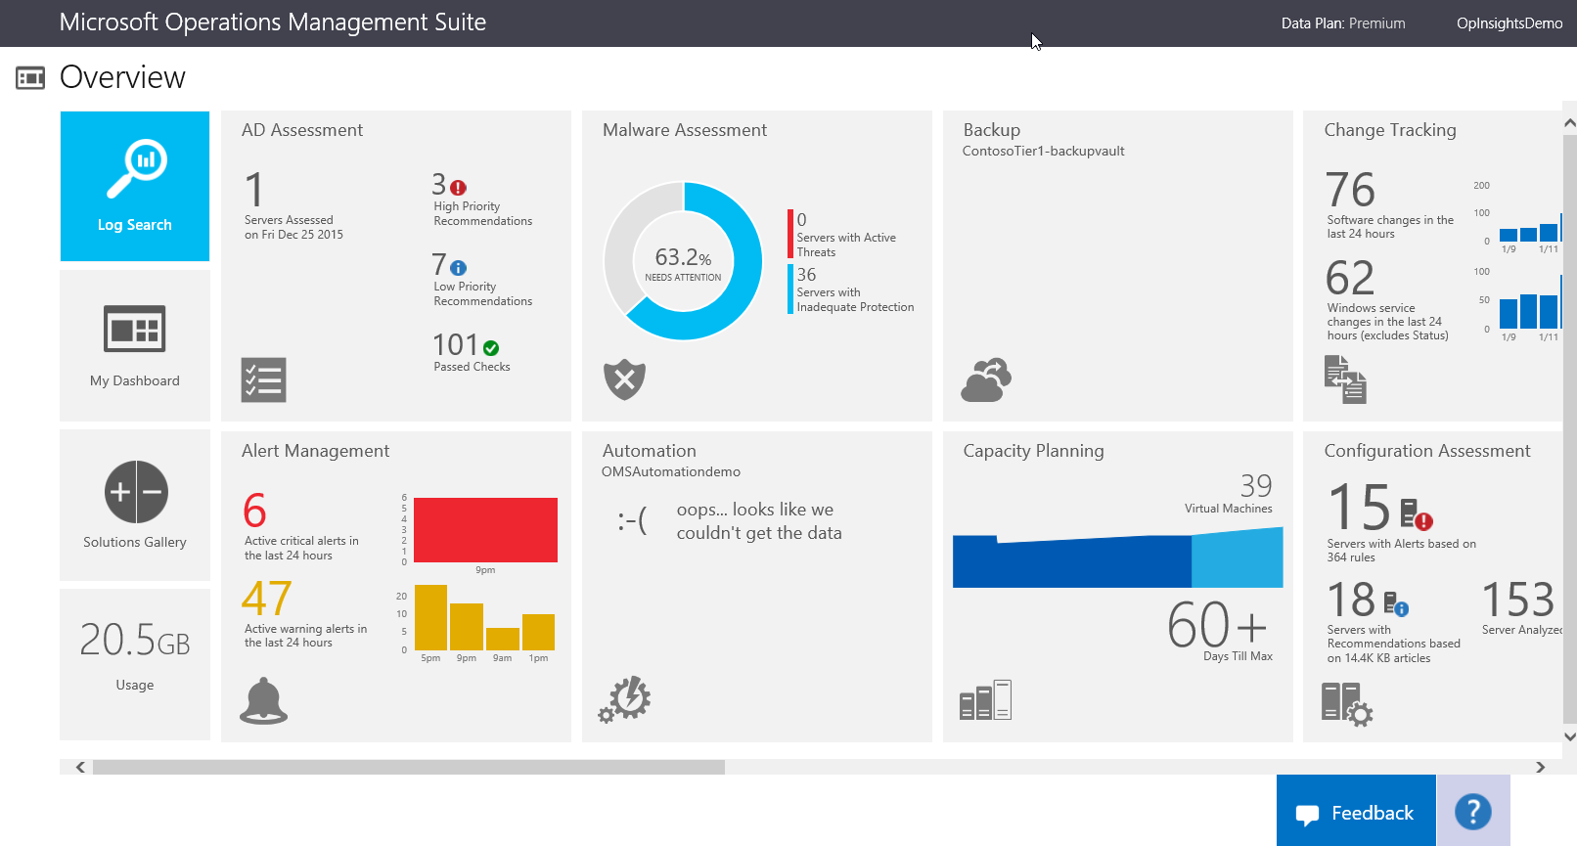
ANALYTICS continued
Azure Operating Management Suite is used for overall Monitoring
Using Azure Log Analytics, you can aggregate monitoring data from Logic Apps to Azure Operating Management Suite (OMS)
Raise alerts when there are failures

Slide 31
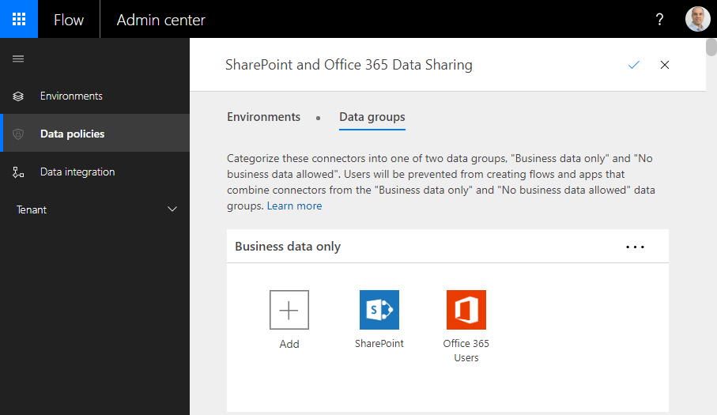
DATA GOVERNANCE AND SECURITY
Power Automate lets admins create data policies to limit how flow can share data between systems
Due to strict access restrictions within Azure, there are no specific Data Loss Prevention rules in Logic Apps
Azure Identity Access Management (IAM) rules can be used to limit creation & access to Logic App (applied to individuals or Resource Group level)

Slide 32















GATEWAYS
Gateways enable cloud-based workflows to interact with on-premises data
Power Automate
Common
Logic Apps
HTTP with Azure AD
Application
Server
Message
Server
Custom
Connectors

Slide 33
LICENSING AND COSTING

Slide 34
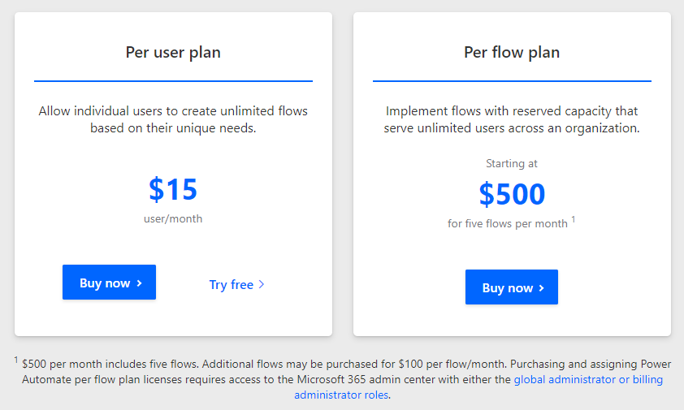
LICENSING MICROSOFT FOW
Cost is License/User based
Refer to Licensing overview for Power Platform (https://docs.microsoft.com/en-us/power-platform/admin/pricing-billing-skus)

Slide 35
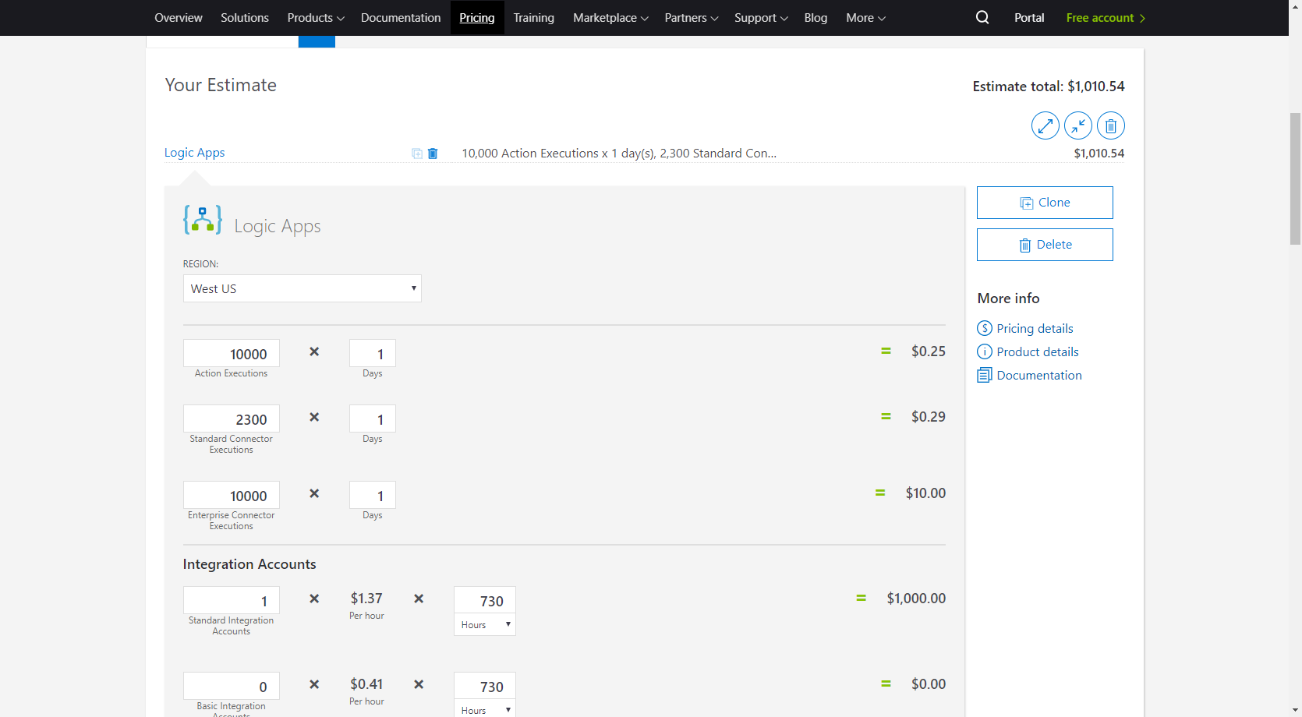
LICENSING AZURE LOGIC APPS
Cost is resource consumption-based
Cost depends on numerous factors
No. actions
No. Standard / Enterprise Connectors
No. ISE
No. Integration accounts
Refer to Microsoft Pricing Calculator (https://azure.microsoft.com/en-us/pricing/calculator/?service=logic-apps)

Slide 36
CHOOSING THE RIGHT SOLUTION

Slide 37


MAKER COMMUNITY
Consider the individuals who are developing your workflows
Power Automate
Azure Logic Apps
Access to Office 365 or Dynamics 365
Citizen Developer, who understand the general concepts and are tech savvy
IT Pros, business analysts, system analysts, and even end-users building them
Access to Azure
Seasoned developers with an understanding and background in DevOps and AML
Comfortable working directly with code
Follow best practices for development

Slide 38
PERMISSIONS
Access may dictate the solution
Power Automate
Azure Logic Apps
Users licensed with Power Automate flow can manage and share their flows across the organization
DLP rules that apply to an environment or tenant
Access to create and manage Logic Apps can be configured by user or resource group
Better suited for strict compliance/regulatory needs (e.g. SOX) that require segregation of duties

Slide 39
DEVELOPMENT ENVIRONMENT
Environment and tools can influence usage of one technology over another
Power Automate
Azure Logic Apps
Office 365 or Dynamics 365
Power Automate flows are developed and managed via a web browser
Streamline development through Templates
Work individually
Azure
Developed and managed via a web browser inside Azure Portal or Visual Studio
Develop using code for optimal flexibility
Work in a team

Slide 40
INTEGRATIONS
Need to understand how workflows interact and interface with other systems
Power Automate
Azure Logic Apps
Process data as output from Power Apps
Require approvals in my workflows
Create Business Process Flows
Trigger Power Automate flows instantly
Work mainly in JSON
Need to integrate with various Azure resources
Implement B2B applications that need to leverage EDI, XML validations, and transactions
Work in JSON, XML, flat file, CSV

Slide 41
TIMING
Consider delays in starting the workflows and duration to complete them
Power Automate
Azure Logic Apps
Depending on license, Power Automate will run within 1-15 min from when they were triggered
Flows run up to 30 days
Logic Apps can be configured to run in near real-time using Integration Service Environment
Logic Apps can run up to 90 days
History retention period is configurable

Slide 42
PRICING
Pricing is often an important deciding factor on which way to go
Power Automate
Azure Logic Apps
Power Automate flows with many actions
Many iterations
Logic Apps with fewer actions
Consider environment cost

Slide 43
REFERENCES
Grow up to Azure Logic Apps
https://flow.microsoft.com/en-us/blog/grow-up-to-logic-apps
Licensing overview for Power Platform
https://docs.microsoft.com/en-us/power-platform/admin/pricing-billing-skus
Limits and configuration information for Azure Logic Apps
https://docs.microsoft.com/en-ca/azure/logic-apps/logic-apps-limits-and-config
Microsoft Flow - Choose a plan that's right for you
https://us.flow.microsoft.com/en-us/pricing
Logic Apps Pricing
https://azure.microsoft.com/en-ca/pricing/details/logic-apps

Slide 44




THANK YOU!
Organizers, Sponsors and You for making this possible.
linkedin.com/in/hanielcroitoru
@hcroitoru
haniel.croitoru@protiviti.com
https://www.agileo365.com
linkedin.com/in/daniel-santos-616552144
daniel.santos@protiviti.com

Slide 45
Thank You For Attending

